Slide 1
SOCIAL MEDIA USE IN THE WORKPLACE
Write You Name Here

Slide 2
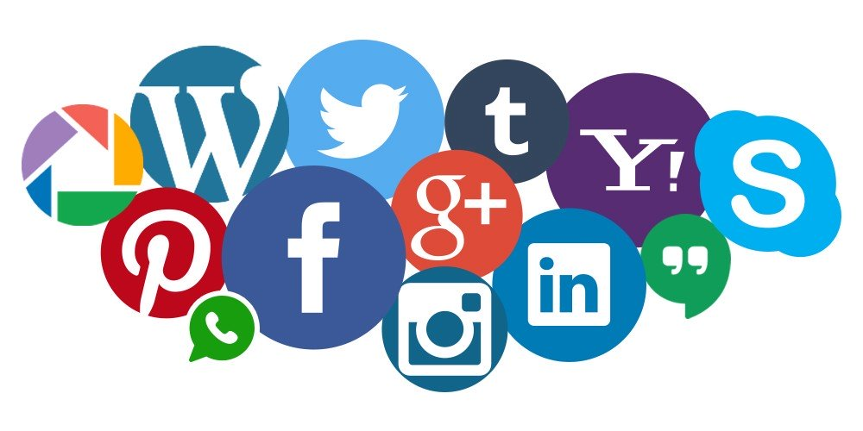
Introduction
The name social media is driven from its users. It stands for the one conceptual practice: connecting the people.
Social media entails the use of advanced media technologies such:
Twitter
Instagram
Facebook
WhatsApp
WeChat
YouTube
Notes:
With each of the above media platforms possessing various features that second what they stand for, inculcating them at the places of work have not received so much accolade over the years. They have nevertheless proven the task of time in the yielding of better results at the organizations that uses it. The above mentioned social media platforms are the major or infamous ones among the growing list of such technologies. Their uses are made simpler through the availability of simple instruments or gadgets likes mobile phones and computers whose costs covers can be covered according to the financial endowment of the person. The accessibilities of these social media platforms are supported by the use of wireless networks like Wi-Fi or mobile network provided data bundles. The application of these advanced technologies in the places of work can lead to merits and demerits as shall be discussed in the subsequent slides.

Slide 3
Merits of Using Social Media at Workplaces
Merits of social media usage at places of work
a.) Allows employees to take the metal break at work
Just like ordinary breaks, employees can as well use the social media to ease their minds
Saves time
Funny content alleviates the bad moods at workplace brought about by stress of work
Notes:
21st century is one that has inevitably presented, currently consumes and depends greatly on the technological innovations. Whereas some organizations censor the use of social media within the work environments, studies show that no matter what, 70% of the workers engage the use of social media platforms at least once in the course of working hours. The purported reasons are worth their while as allowing the employees to browse these platforms provides the necessary break from mental torture that comes with work. Like tea breaks and lunch breaks, letting the employees to spend a few moments on the media can enhance happiness when they have had rough schedules. It also saves time that they would use to move from one point to another (say break room to the work station) as is described by Brooks, Longstreet & Califf (2017).

Slide 4
Continuation of Merits…
B) The use of social media enables employees to make and support professional connections with other organizations in the same business.
    strengthening relationship with other people
    Borrowed problem solving techniques
    Boosts sales, creativity and provides opportunities
Notes:
It has been realized over the years that people integrate and form groupies from home, families, friends and colleagues from work and all around. They equally do this by including individuals of all professions. Sharing of information across the given platforms help in providing solutions to problems that are experienced in one organization to the other. The company members get to know their competing others in the same industry. This can lead to borrowing of information that can improve the work efficiency of the given company. Any organization that permits its workers to freely share or exchange information on media platforms allows growth. Facebook for instance has been greatly used as a platform to conduct sales promotions. There are other organizations such e-Bay that accrued customers to their own platform by first of all conducting their sales on the social media. In a nutshell therefore, opportunities can easily arise to the individuals or the companies that permit the workers to access online platforms at least once or twice in the office as Holland & colleagues (2016) posit it.

Slide 5
Continuation on Merits…
C.) The use of the platforms provides cohesion among co-workers
    problem-sharing
    Teamwork among the members of a department
    They boost morale among workers
    Establishes long lasting friendships among member workers.
Notes:
Since the inception of Whatapp, a platform that allows its users to send and receive content (files, pictures, videos and documents), majority of work related meetings have been reduced to take place on this platform. In the cases that call for discussions that would take lesser hours compared to the actual meetings, the platform has also provided necessary room to effect fewer minutes and time saving. Problem sharing has also been equally addressed through the social media platforms. One may layly pass that “ I don’t want to meet my boss” while in essence they mean that they are escaping the wrath that would comes with meeting their bosses. Applying this kind of platform usage to the given places of work provides a platform that members of that organization can use to bind themselves together in for instance generating financial assistance. The members of given departments can furthermore share work experiences as they also help one another with information alternatives on how to tackle given areas of assignments. This forms the basis of the required teamwork. Online platforms as they are also referred to, encourages the workers to keep up with their jobs. Knowing that at a given time and place a friend posts that he or she is busy as bee carrying out his work can imminently motivate another person to do the same. Studies in psychology have recorded that online platforms can lead to very long-lasting associations among coworkers. This takes place just like it does when the members of an organization are either transferred to other stations or retires. The most that work-related platforms can do is keeping in touch with colleagues while one is away. It provides a sense of belonging to a place even when far away.

Slide 6
Organizational Impacts of using Social Media at Workplaces
The use of social media at work allows for discoveries of information that can be privy to work productivity
  Helps in identifying the market trends
  Provides knowledge about other companies offering the same product as you
  Helps in identifying the new markets for the company as well as marketing
Notes:
Organizations are going out of their way to meet the rising market demands. Unlike the traditional methods used to gain information such the use of televisions, radios and newspapers, inculcating the modern technology into concepts of market such as customer feedback, market trends, competition techniques other ventures help improve efficiency in running businesses. It should, in addition be noted that even the bosses nowadays one will not be surprised to find them navigating online. Allowing individual members to measurably use these platforms can enhance above effective endeavors in the company.

Slide 7
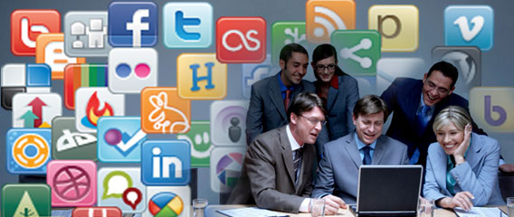
Continuation on Organizational Impacts of Using social media at workplaces
Social media use can help boost organizational productivity
Finding new ways of improving job efficiencies
Helps customer connectivity
Elevation of company-customer relationship
Notes:
There are institutions that allow employees to be assigned certain tasks that needs turn-in reports. The very first places they (employees) run to get the gist of the information they need is online. And in most cases they do this while ensuring nobody is in notice of what they do. Either way they end up coming up with very creative ideas that that corresponds to the needed output of the company. Twitter for instance has been used by multinational corporations and government agencies to disseminated critical information that pertains a given product. In 1997 in Belgium when Coca-Cola company distributed drinks that rendered nearly 100 children ill, the company used social media as a way of apologizing and accepting responsibilities of the defects that were occasioned by their products. The bigger picture in this case is found on the grounds that social media usage can help disseminate the vital information much faster that any other outlet known within given contexts. This is the same thing that is experienced through the company-customer relationship. Companies have registered themselves online making it easier to be reached by their clientele. It is also poignant to note that there are companies that almost partially conduct their services on the online platforms . Think of bus and airline ticket bookings.

Slide 8
Continuation of Organizational Impacts of using social media at workplaces
Using social media at places of work improves employees retention and acknowledgement
  The management can keep tabs on employee work turn-ins
  The company can form a platforms that determines the effectiveness of employees
  Provides a company with transparency needed on individual approvals
Notes:
Technologies such as People Analytics have revolutionized the ways to evaluate and analyze individual worker effectiveness to an organization he or she works for. Most organizations have also utilized social media platforms for instance Whatsapp to attest the competences of individual such on time submission of work are the efficacies that come such works. In more open ways that realized the platforms such whatsapp enables the company to boldly share the improvements witnessed by performances of individuals that will determine the variability of whether the person ought to stay on the job or not.

Slide 9
Demerits of Using Social Media at Workplaces
These are the challenges posted by allowing the workers to use online platforms during the working hours
a.)Very addictive if unchecked
  Time consuming
  Deflects on normal pastime
  Keeps users on rather unproductive manner
  Low performance
Notes:
Individual continued use of these social media websites can become very addictive to the point that job performance severely deteriorates making the job to come at second place to online websites. This comes to be when these fellas report to work station in the morning and the very first thing they do is to jump to the internet (Brooks, Longstreet & Califf (2017). It proves to continue waste a lot of time that would in turn be very productive and yields good returns to the company. Addiction to the online websites lead to deflection of ones pastimes such as socialization among others. The person becomes inherently engrossed to his or her phone to the point that his life seem to life by his phone or computer. The general expectations in the person slowly degrades as they are driven by the amount of likes comments and the number of shares he or she gets from these platforms. These in the end become rather unproductive tendencies and low performances at assigned tasks.

Slide 10
Continuation of Demerits
b.) Can lead to loss of privacy at work
  one discloses things he should not
  Judgment of personalities kicks in
  Fall in self respect
  Mockery
  Weakness in resultant character formation altogether
Notes:
Permitting unsupervised usage of social media websites at work places especially Instagram, has in many cases reported instances that entailed loss of privacy and eventual dismissal or resignation from work. It comes with extreme addiction that prevents one from realizing that he or she is in the public domain. The ladies are the majority that correspond to this. They share through offs the likes they have a picture, the followers they have got and the self ascribed popularity and becoming the order of their lives. In the event a leakage of such data takes place at a work station as it effects the same to families as is captured by Salaria & Ambereen (2018). These individuals become subject to mockery stigma and may decide to fall out by quitting their jobs. It also impacts on the loss of respect and judgment of personalities. The victim anchors his life totally on attention gotten from using online websites that will result into very weaker characater altogether.

Slide 11
Continuation of Demerits…
c.) Leads to cropping up of undesired personalities and makes one psychologically unhealthy
  such as jealousy
  Conflict among coworkers and superiors
  Laziness
  Addiction leads to dependence on the virtual world for approval
  constant out of place
  Low perception on other people who do not
Notes:
Organizational conflicts can be triggered with as little as a negative statement from a work colleague that happens to comment something that goes vis-à-vis the expectation of another workmate that likes to stay online for too long. The victim in this case becomes so emotional to the point of either breaking down, feeling moody and reluctant to share all that is needed in a teamwork in the office. Characters such jealousy, rivalry laziness and so on crop up amidst of the workers that in the end threatens achievements of organizational goals (Salaria & Ambereen 2018).
The addiction that have been discussed in the earlier slides can furthermore lead to extreme dependence on the virtual world in search of approvals that come with the sharing of posts, people liking your picture and videos, comments going beyond hundreds and so on. Attachment to these virtual concepts have resulted into so low outputs in the work environment. Those who get these kinds of feeds online have shown and cultured superficial importance about themselves as they depict other people to be zero relevance to themselves. It has become the norm until going without them effects so negatively on person.

Slide 12
Balance Between Social Media and Workplace
The are a number of measures that organizations can put in place to ensure harmonious integration on the use of social media and implementation of set work objectives.
  Outlining work guidelines
  Sensitizing the workers on the Pros and Cons
  Encouraging teamwork for all departments
Notes:
Outlining Work Guidelines
Every organization have missions and both the short term and long goals they would like to achieve. Equally these organizations have incorporated in their systems the use of one or two technological innovations within their offices. This can be taken to mean that they are aware of the social media use. What they need to do is to come up with distinctive policies that will not bar individuals from using these platforms but nonetheless do things to encourage productivity. In a fewer terms, the organization can endeavor to fully allocate some minute intervals for people to free up themselves by either using the platforms of taking ordinary breaks. When it comes to work let it be realized that it is work and no surfing would tolerated.

Slide 13
Continuation of Balance Between Social Media and Work…
Case studying e-commerce companies like Amazon, E-Bay and Ali Baba
Sensitizing the workers on the dos and don’ts
Benchmarking with companies that have included the use of social media to companies elements of operations.
Exemplification of impression given to the juniors
Notes:
This should be the case that applies to the new employees and junior interns. However prejudiced and unbalanced this policy maybe, it should however be noted that this lot at a given work place usually come as green as Greenland. And therefore advanced orientation on the requirements of the company should mark the emblem of their undertakings in the new work environment. Exemplified by the first impression given to the juniors, they follow what they see. It is a mandatory that the organization gives out proper sensitizations on the advantages and dangers that can be met by using social media at work places.
Telecommunication companies, media outlets and high learning institutions are best known to echo the services provided by social media networks. Borrowing a leaf or two by mega companies can result into doubling the outcomes of a business in terms of revenue generation and publicity among its consumers. Lloyds Of London, one of the leading insurance company in Europe started by benchmarking levels of productivity as was carried out by other insurers, to date they have overshadowed the other mega insurance organizations especially in Britain. Therefore any company that chooses to incorporate the social media services needs to first of all things try out from how the concept worked for other entities before rolling it out to your organization.
The current flamboyant e-commerce companies like Amazon, E-Bay, Ali Baba and so on started their online purchasing platforms inherently through using the then available social media website. They are at given points had smaller geographical storage facilities from where they operated before they shifted focus to conduct their businesses online. It is advisable that with the current crop of social media websites, any company that is to allow its members to engage in their use during the working hours, need to set out the reasons for doing so although personal preference will overhaul the practice to a given magnitude. Providing strict measures can help achieve the organizational goal of going global if discipline is meant to become part of this achievement.

Slide 14
Conclusions
This paper has offered in terms of the various explanations, the needs to fuse together using social media at work places and on the other hand also pointed some of the shortcomings of social media and the measures that can address the short coming.
Notes:
We all accolade having used a given social media outlet if not all at one point or another. We equally exemplify the results of having used them at our personal spaces and that of the general public and most so at the work places. As we cherish and merry over the continued developments captured through the use of social media, it is appropriate to weigh the pros and cons of such mileage at the places of work. It is in summary insightful to go through the concepts outlined in this paper so as to equip oneself for what is needed at the work station.

Slide 15
References
Brooks, S., Longstreet, P., & Califf, C. (2017). Social media induced technostress and its impact on Internet addiction: A distraction-conflict theory perspective. AIS Transactions on Human-Computer Interaction, 9(2), 99-122.
Holland, P., Cooper, B. K., & Hecker, R. (2016). Use of social media at work: a new form of employee voice?. The International Journal of Human Resource Management, 27(21), 2621-2634.
http://www.egroupengage.com/blog/the-pros-and-cons-of-social-media-in-the-workplace
Salaria, M. R., & Ambereen, B. (2018). Journal of ISOSS 2018 Vol. 4 (2), 145-154 IMPACT OF SOCIAL MEDIA ON FAMILY LIFE. Journal of ISOSS, 4(2), 145-154.

